Slide 2
4
THE KEYBOARD
LESSON 01 : KEYBOARD INTRODUCTION
LESSON 02 : BASIC KEYS
LESSON 03 : FIXING MISTAKES

Slide 3
01
KEYBOARD
INTRODUCTION

Slide 4

Student Goals
I can verbally identify the keyboard and its function.
I can label the different rows of the keyboard: Function, Number, Top, Home, Bottom, and Command.
I can place my fingers correctly on the home row for typing.

Slide 5
Lesson Outline
Warm-up & Review
Keyboard Overview
Keyboard rows
Finger Placement
Evaluation

Slide 6


DIRECTIONS
Review & Warm-Up
Find WordPad on your desktop
Click & Drag to the top right corner
Click & Drag to the bottom right corner
Double click to open
Click on “new document”

Slide 7
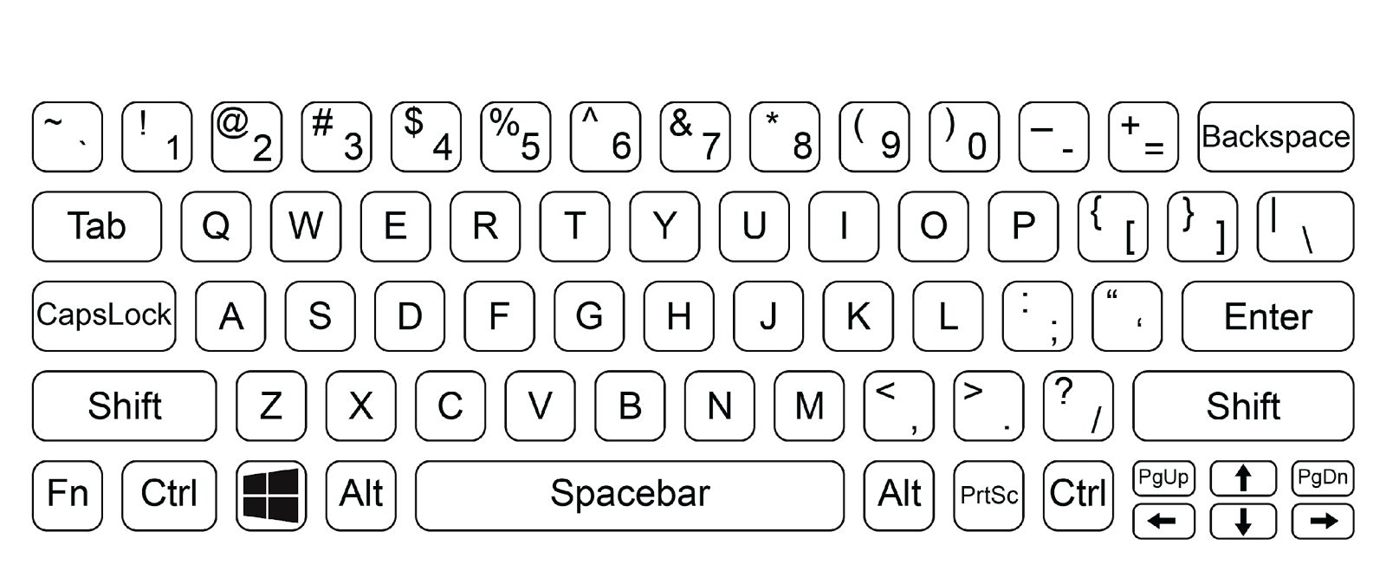
Keyboard Overview
Type (v): to write with a computer keyboard.

Slide 8
Keyboard Rows
Row (n): a straight line of people or things that are next to each other.
Function (n): the special purpose or activity for which a thing exists or is used for.
Command (n): an instruction in the form of code (computer language) or signal that tells the computer to do something.

Slide 9
Types of keys on the keyboard
Pick a color for each type of the key we’ve talked about so far. Color each key in that type with that color.
We’ve done all the letter keys for you ; you do the rest !
Letter Keys
Number Keys
Character Keys
Spatial Keys
Modifier Keys
System Command Keys
Navigation Keys

Slide 10

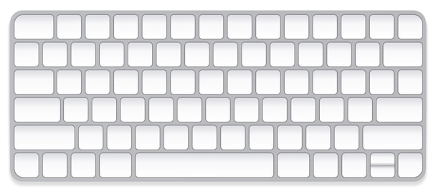


Finger Placement
Notch (n)
a small bump or cut on an edge or surface.
Placement (n)
The act of putting something in a particular location.

Slide 11
Activity
Fingers and Keys Worksheet

Slide 12
DIRECTIONS
Evaluation
Use what we’ve learned, do the following actions and note down your observations.
1
Type your first and last name.
2
Press: “enter”
3
Type: “My keyboard has __________ rows”
4
Type: “My pointer fingers should be on the ____ key and the _____ key”

Slide 13












Achievements
I can verbally identify the keyboard and its function.
I can label the different rows of the keyboard: Function, Number, Top, Home, Bottom, and Command.
I can place my fingers correctly on the home row for typing.

Slide 14
02
BASIC KEYS

Slide 15
Student Goals
I can find common punctuation on the keyboard.
I can name the 1st four groups of keys and what they are: letter, number, character, and spatial.
I can name and state the job of each spatial key.

Slide 16
Lesson Outline
Review & Warm-up
Letter Keys
Number Keys
Character Keys (Punctuation & Symbols)
Spatial Keys
Evaluation

Slide 17
Vocabulary Review
Special (adj.):
Different from what is normal or usual.

Slide 18

Review & Warm-Up
Conversation
notes
What are the types (categories) of keys we learned about last time?
Which keys should your pointer fingers rest on?
Which keys should your ring fingers rest on?
Which keys should your middle fingers rest on?
Which keys should your pinky fingers rest on?
__________________________________________________________________________________________________________________________________________________________________________________________________________________________________________________________

Slide 19
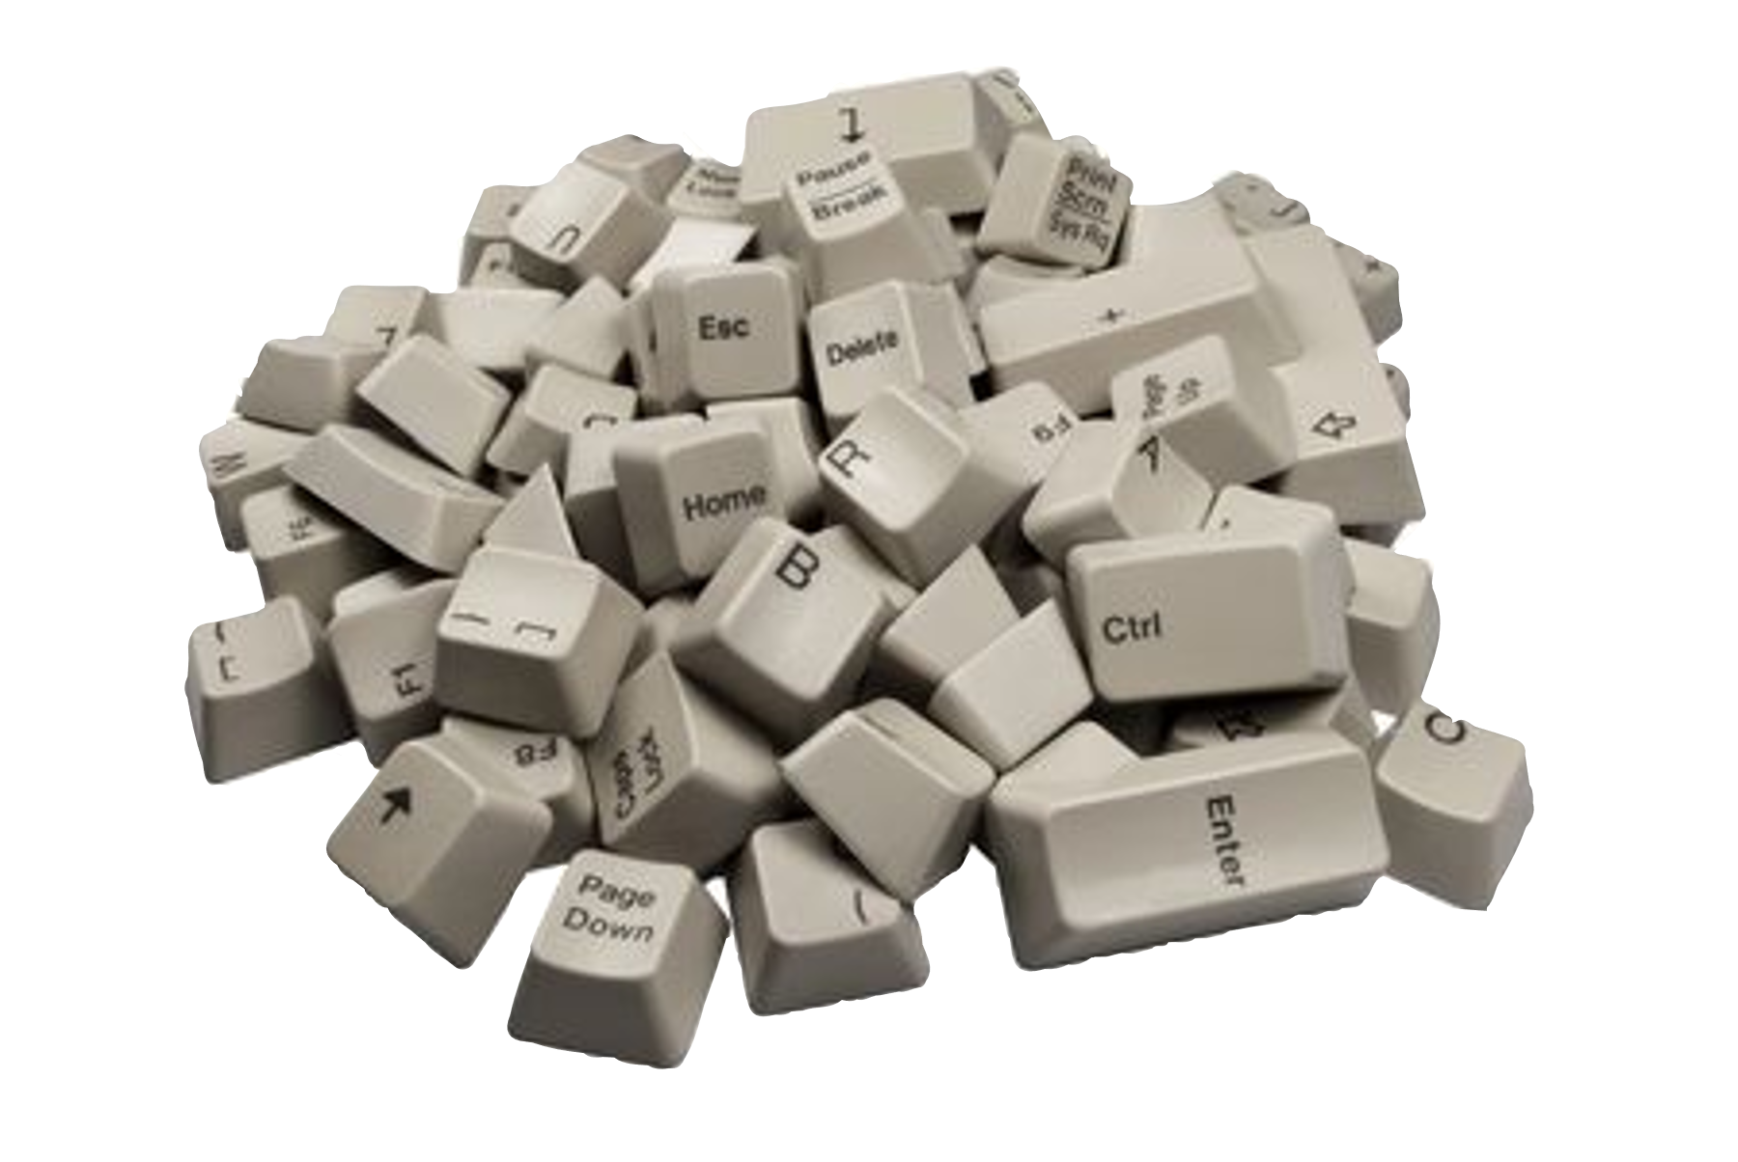
Types (categories) of Keys for Today
Letter Keys
Number Keys
Character Keys
Spatial Keys

Slide 20
1
Letter Keys
What are letter keys?
How many letter keys are in the top row?
How many letter keys are in the Home row?
How many letter keys are in the Bottom row?

Slide 21
2
Number Keys
What are number keys?
What are the number keys? Where are they located on the keyboard?

Slide 22
Number Keys
Open your document from last class. Type the sentences blow.
Complete the sentences
I was born in the year ___________.
I am __________ years old.
My address is ____________________.

Slide 23
3
Character Keys
Punctuation and Special Symbols on the Keyboard

Slide 24
3
Character Keys
2. Special Symbols
Punctuation
~ | Tilde |  | ^ | Hat
` | Acute or Grave Accent |  | & | And
@ | At |  | * | Asterisk
# | Number or Pound |  | _ | Underscore
$ | Dollar Sign |  | + | Plus
% | Percent |  | = | Equal
< | Less Than or Angle Brackets |  | > | Greater Than or Angle Brackets
/ | Forward Slash |  | \ | Back Slash
| | Pipe or Vertical Bar
, | Comma |  | . | Period
? | Question Mark |  | ; | Semicolon
: | Colon |  | ‘ | Apostrophe
“ ” | Quotation Marks |  | ! | Exclamation Mark
- | Dash |  | ( ) | Parenthesis
[ ] | Bracket |  | { } | Braces

Slide 25
4
Spatial Keys
What do you think spatial means? Is there a word we know that it sounds like?
Spatial keys are keys that have to do with making or erasing spaces.
What keys make or erase space?

Slide 26
4
Spatial Keys
Key Name | What does the key do?
S_______
T__
E____
B________

Slide 27
Types of keys on the keyboard
Pick a color for each type of the key we’ve talked about so far. Color each key in that type with that color.
Let’s complete what we started !
Letter Keys
Number Keys
Character Keys
Spatial Keys
Modifier Keys
System Command Keys
Navigation Keys

Slide 28
DIRECTIONS
Evaluation
Use what we’ve learned, do the following actions and note down your observations.
1
Where can I add punctuation to my document?
________________________
2
Which keys should I use?
________________________

Slide 29
Achievements
I can find common punctuation on the keyboard.
I can name the 1st four groups of keys and what they are: letter, number, character, and spatial.
I can name and state the job of each spatial key.

Slide 30
03
FIXING MISTAKES

Slide 31
Student Goals
I can point out the blinking cursor.
I can move the blinking cursor with the mouse and/or the arrow keys.
I can use delete to fix a misspelled word.

Slide 32
Lesson Outline
Review & Warm-up
Making mistakes
The Blinking Cursor
Moving the Cursor
Delete vs. Backspace
Evaluation

Slide 33
Vocabulary Review
Blink (v):
to flash; to shine with a light that goes on and off.

Slide 34
Review & Warm Up
Conversation
notes
Describe three different keys to me.
Identify a spatial key.
→ What does it do?
Challenge: Identify a character key that you use.
→ When and why do you use it?
__________________________________________________________________________________________________________________________________________________________________________________________________________________________________________________________

Slide 35

Making Mistakes

Slide 36


Blinking Cursor
Point to the cursor in your document

Slide 37
Moving the Cursor
Fix Spelling Mistakes

Slide 38
DIRECTIONS
Evaluation
Do the following actions
1
Type these sentences into your document
I go to skool
I learn Englisch
Challenge sentence : On Satirdays, I relax.

Slide 39
Achievements
I can point out the blinking cursor.
I can move the blinking cursor with the mouse and/or the arrow keys.
I can use delete to fix a misspelled word.

Slide 40
04
SPECIAL KEYS

Slide 41
Student Goals
I can name the last three groups of keys, their purpose, and location on the keyboard (Modifier, Navigation, and System Command).
I can name and use keys appropriately for their intended purpose.

Slide 42
Lesson Outline
Review & Warm-up
Modifier Keys
Navigation Keys
System Command Keys
Evaluation

Slide 43
Vocabulary Review
System (n):
a group of related parts that move or work together.
Command (n):
an order given to a person or thing to do something.

Slide 44
DIRECTIONS
Review & Warm-Up
Finish the sentences and copy the sentences in notebooks. (Challenge: Type up after written)
1
Today is _____.
2
Spatial keys are ____.
3
Backspace ____.
4
I can move the blinking cursor in two ways:
1. _____________ and 2. _____________ .

Slide 45

Modifier Keys
Modify (v)
to change something.
Sentence: The SHIFT key modifies any letter key.
1
Shift Key
2
Caps Lock Key
3
Control Key (Ctrl)
4
Function Key (Fn)
5
Alternate Key (Alt)

Slide 46

1
Shift Key (⇧)
Shift (v)
Means to move or to cause something to move or change.
The Shift key helps us make big letters and special symbols.
Press it with a letter for big letters or to get the top symbol on a key.

Slide 47
Using the Shift Key
Type the following sentence on your computer in a new Word/Wordpad document.
Computers are very expensive. They usually cost more than $800!

Slide 48

2
Caps Lock Key
Caps Lock key makes all letters capital without holding down a key (unlike shift). Press it once to turn it on, press it again to turn it off.

Slide 49
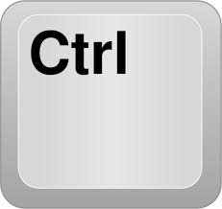
3
Control Key (Ctrl)
The Control key, or Ctrl, helps make shortcuts with other keys. It helps do things faster in programs.

Slide 50
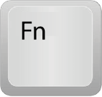
4
Function Key (Fn)
The Function key, or Fn, changes the first row (the function row) of keys on some laptops. The Function row keys all have an “F” and a number. These can be customized to do a special action.
The Fn key allows you to switch between a customized action and the action related to the big icon on the key like volume and brightness of the screen.

Slide 51
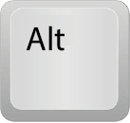
4
Alternate Key (Alt)
Alt key, or alternate key, makes special shortcuts when we press more than one key together.
It helps do different things in programs.
Alt key shortcuts are similar to Control shortcuts but more advanced.
Alt shortcuts usually need more than 1 letter key to make a shortcut work.

Slide 52
Navigation Keys
Navigate (v)
Find the way to go somewhere
Sentence: Navigation keys help us move around the computer to find things.
1
Arrow Keys
2
Page Up & Page Down Keys (Pg Up – Pg Dn)

Slide 53
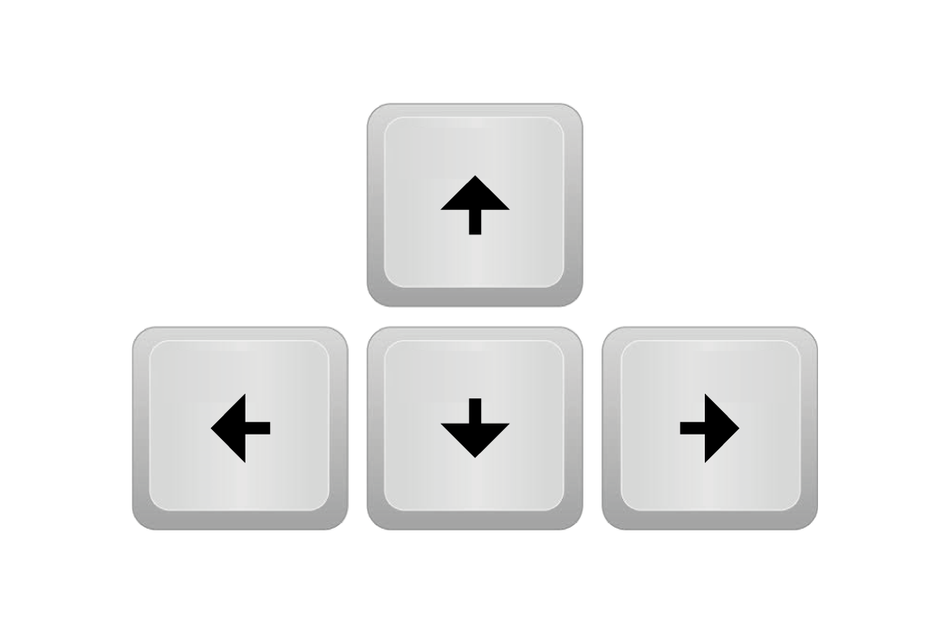
1
Arrow Keys (↑ ↓ → ← ↑)
Arrow keys are special keys that look like arrows. They’re usually in the bottom right corner of the keyboard.

Slide 54
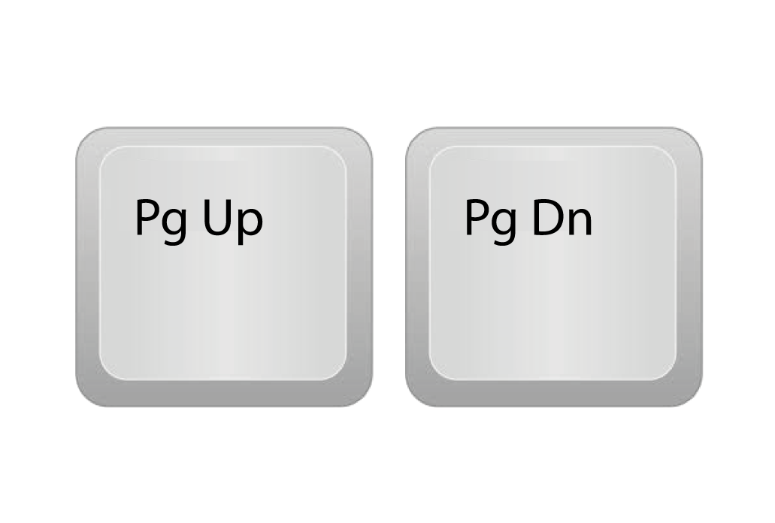
1
Page Up & Page Down Keys (Pg Up – Pg Dn)
Page Up and Page Down keys : often written as PgUp and PgDn, help us move a whole page up or down on the screen. It's like turning a page in a book on the computer.

Slide 55
Using the navigation keys
practice using the navigation keys to get around to different parts
of what you have written.
Use the navigation keys in your Word document

Slide 56
Types of keys on the keyboard
Pick a color for each type of the key we’ve talked about so far. Color each key in that type with that color.
Let’s complete what we started !
Letter Keys
Number Keys
Character Keys
Spatial Keys
Modifier Keys
System Command Keys
Navigation Keys

Slide 57
System Command Keys
Keys that give the operating system (OS) an order.
1
Enter Key
2
Windows Key
3
Print Screen (PrtScn)

Slide 58

1
Enter Key
The Enter key is like hitting "go" at a green light. This is an additional use to beginning a new line.

Slide 59

1
Windows Key
The Windows key is a shortcut for opening the start menu.

Slide 60
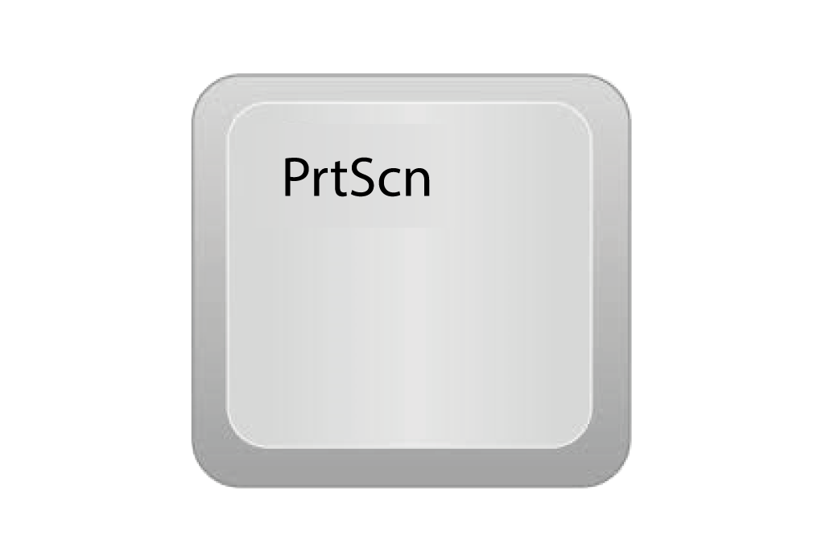
1
Print Screen (PrtScn)
The Print Screen key It's usually at the bottom of the keyboard, like a secret camera button. When we press it, it takes a picture of what's on the screen, just like taking a photo on a phone.

Slide 61
Types of keys on the keyboard
Pick a color for each type of the key we’ve talked about so far. Color each key in that type with that color.
Let’s complete what we started !
Letter Keys
Number Keys
Character Keys
Spatial Keys
Modifier Keys
System Command Keys
Navigation Keys

Slide 62
DIRECTIONS
Evaluation
Leave a bit more time for this last evaluation since it entails a lot of typing.
Optional Challenge: Ask students to type the name and job of each key in the main categories
1
Open a new word document and type the following
Letter keys: Keys with one ______ .
Number keys: Keys that have a _______.
Character keys: Keys with _______ or _______.
Modifier keys: Keys that _________ other keys.
Spatial keys: Keys that _____ or ______ ______.
System Command keys: Keys that give the ________ __________ an order.
Navigation keys: Keys that help you _____ ______ the computer.

Slide 63
Achievements
I can name the last three groups of keys, their purpose, and location on the keyboard (Modifier, Navigation, and System Command).
I can name and use keys appropriately for their intended purpose.

